Slide 1
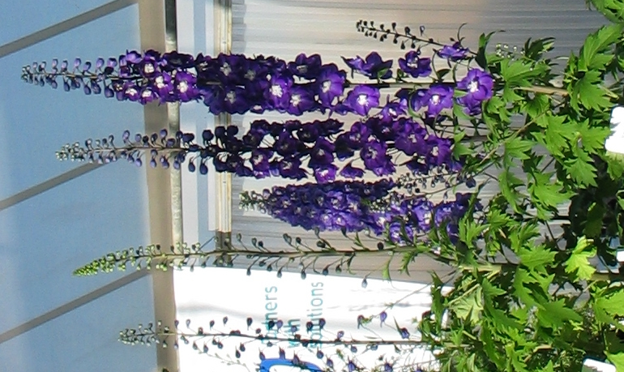
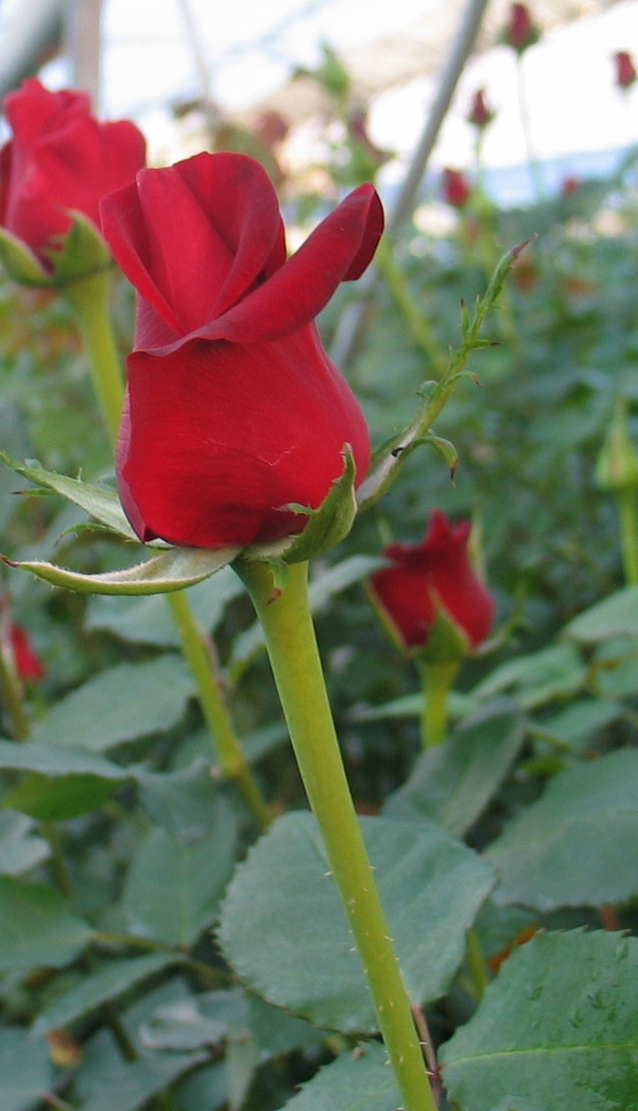
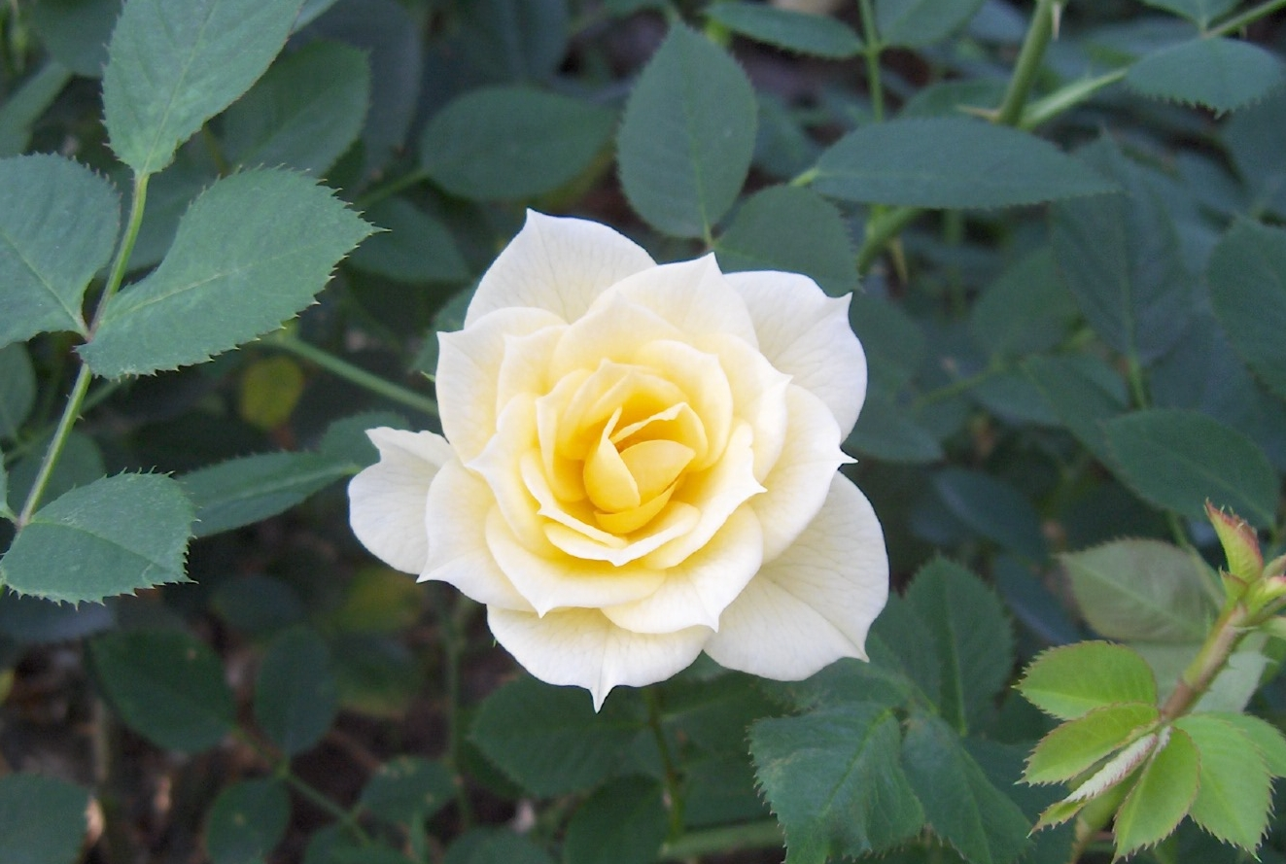
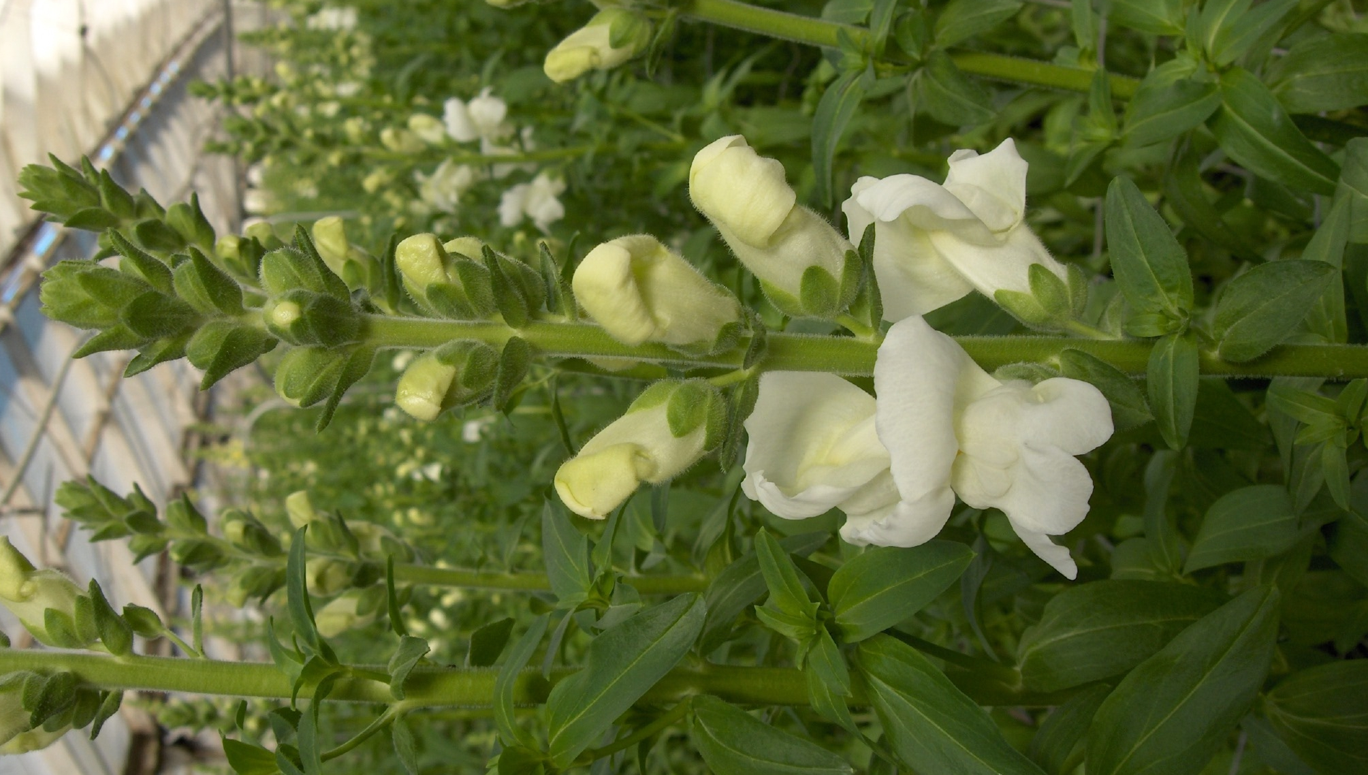
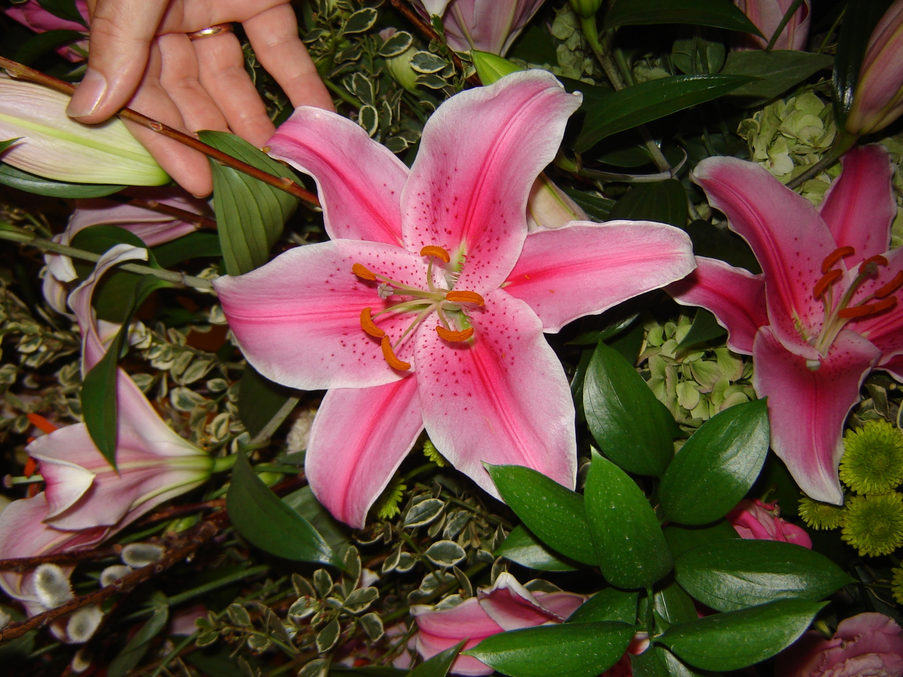
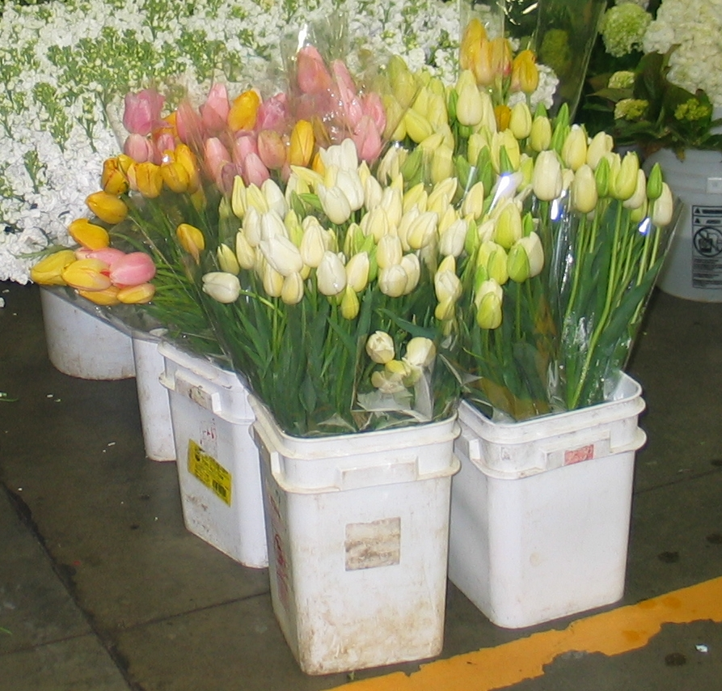
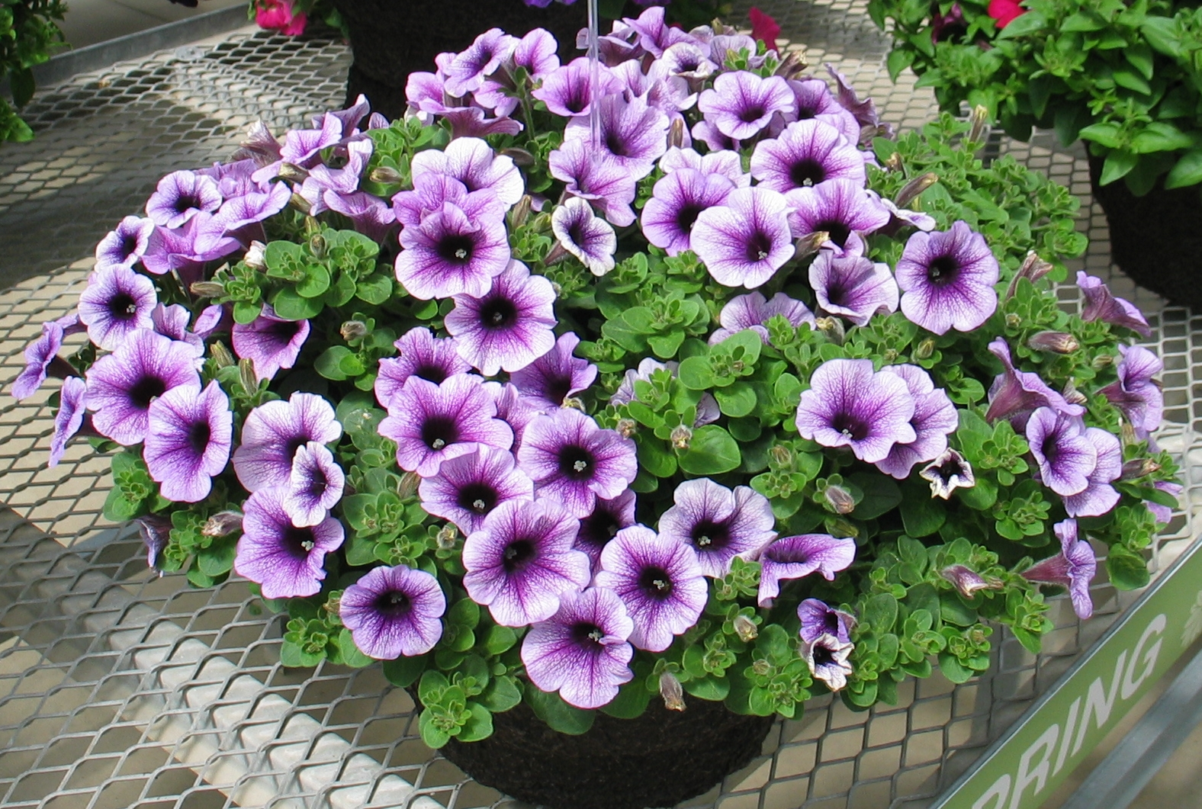
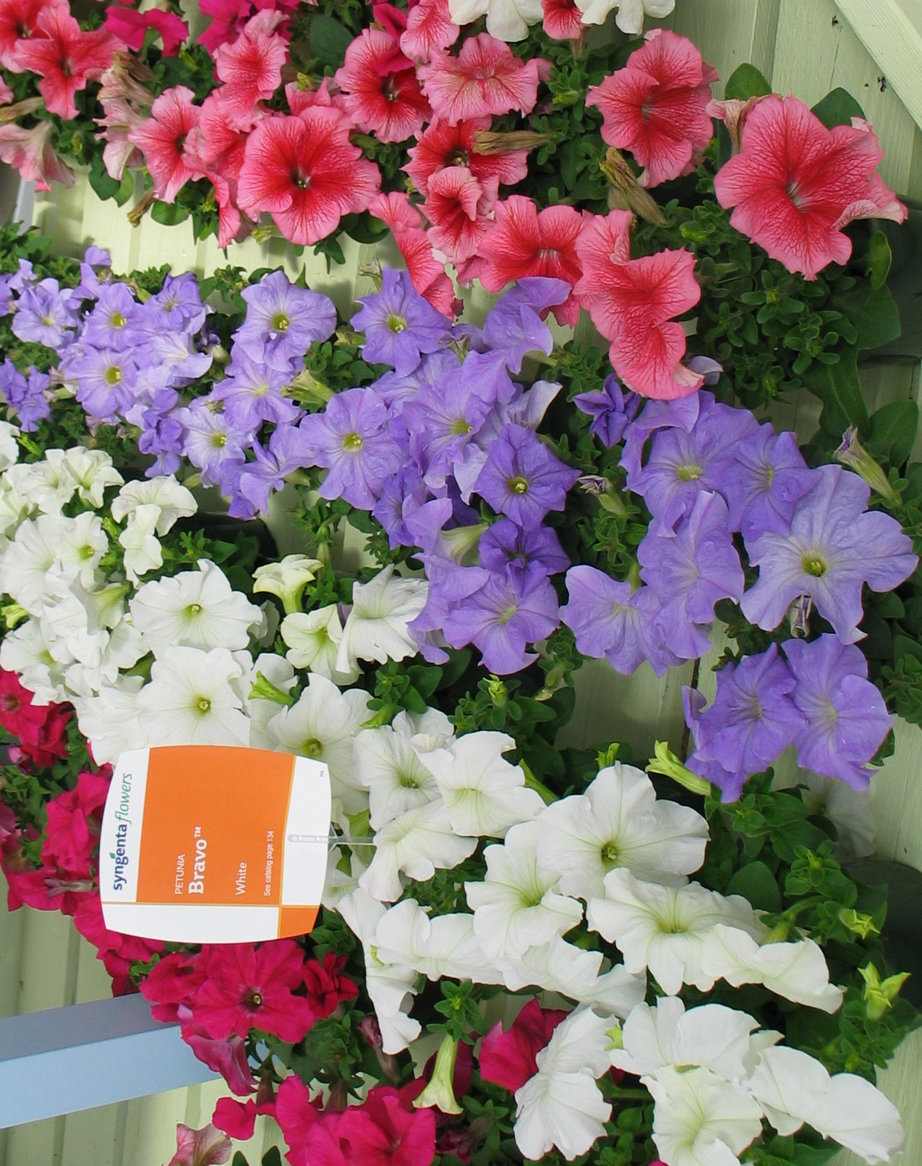
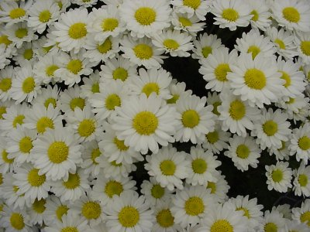
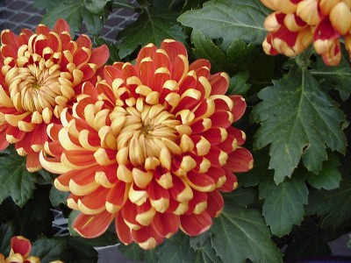
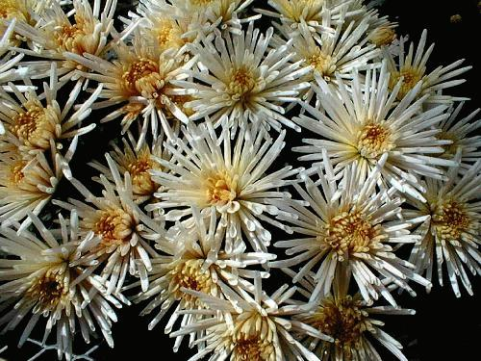
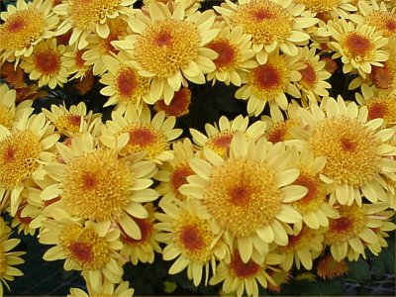

Slide 2
Delphinium
Rose
Oriental Lilies
(Stargazer)
Snapdragon
Tulip
Petunia
Chrysanthemum
Top: Quill type
Bottom: Anemone type
Chrysanthemum
Top: Daisy type
Bottom: Incurve type

Slide 4
Delphinium
Rose
Oriental Lilies
(Stargazer)
Snapdragon
Tulip
Petunia
Chrysanthemum
Top: Quill type
Bottom: Anemone type
Chrysanthemum
Top: Daisy type
Bottom: Incurve type

